Slide 1


Slide 2
A2 Chemistry
Collision Theory

Slide 3
Review
Reaction rate can be measured by appearance of products or disappearance of reactants.
Nature of reactant, state of subdivision, concentration (or partial pressure), temperature and catalysts all affect reaction rate.

Slide 4
Objectives
collision theory can be used to explain and predict the effects of concentration, temperature, pressure, the presence of catalysts and surface area on the rate of chemical reactions
the activation energy is the minimum energy required for a chemical reaction to occur and is related to the strength and number of the existing chemical bonds; the magnitude of the activation energy influences the rate of a chemical reaction
energy profile diagrams, which can include the transition state and catalysed and uncatalysed pathways, can be used to represent the enthalpy changes and activation energy associated with a chemical reaction
catalysts, including enzymes and metal nanoparticles, affect the rate of certain reactions by providing an alternative reaction pathway with a reduced activation energy, hence increasing the proportion of collisions that lead to a chemical change

Slide 5
Key terms
Collision energy
Collision angle

Slide 6
Collision theory
For particles to react, they must
collide with each other
at an appropriate angle
with sufficient E_{k} to overcome E_{a}

Slide 7
Reaction rate is affected by
The total number of collisions
The proportion of collisions that are ‘successful’ in breaking bonds, either due to sufficient collision energy or appropriate collision angle

Slide 8
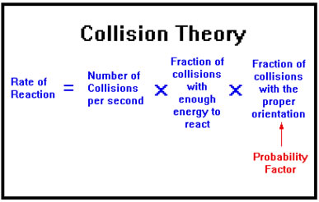

Slide 9
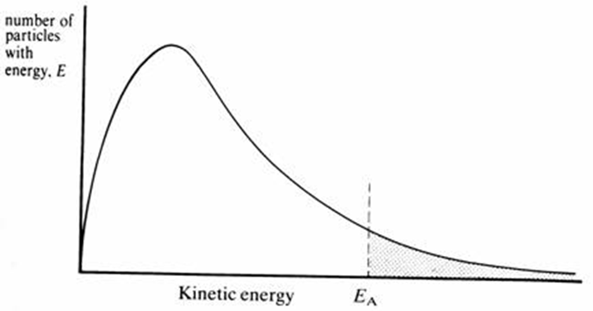
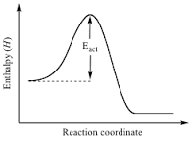

Nature of the reactants
Within any substance, there will be a distribution of energy within particles.
A proportion of them will have sufficient energy to overcome the activation energy barrier.
The lower the activation energy, the greater the proportion of collisions that will be successful.

Slide 10
Activation energy
is determined by the number and strength of bonds to be broken

Slide 11
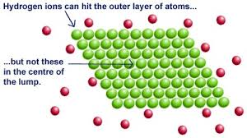
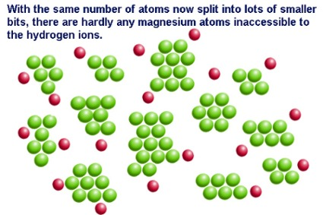
State of subdivision
With more particles ‘exposed’ at the surface, the total number of collisions between reacting particles will increase.
This won’t affect the proportion that are successful, but if there are more collisions there will be more successful collisions.

Slide 12
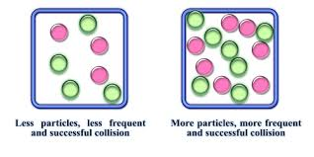
Concentration or partial pressure
The more reacting particles in a volume, the more frequently they will collide with each other
and not some other particle, like water in a solution or
nitrogen in the air.
This won’t affect the proportion that are successful, but if there are more collisions there will be more successful collisions.

Slide 13
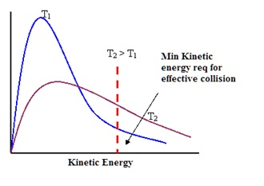
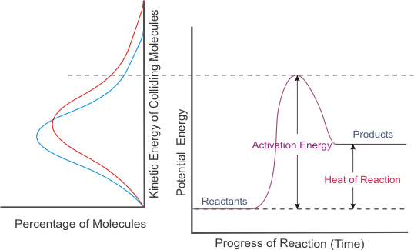
Temperature
Increasing temperature increases the average kinetic energy of reacting particles.
There will be more collisions in total.
There will be a greater proportion of collisions with sufficient energy to overcome activation energy barrier.

Slide 14
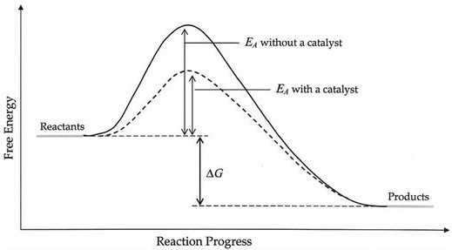
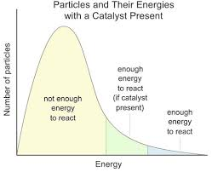
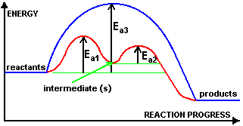
Catalysts
Catalysts provide an alternate reaction pathway with a lower activation energy.
Increases the proportion of successful collisions

